Slide 1

Deep Learning
Session 1
Course Introduction
Applied Data Science
2024/2025

Slide 2
Course Objectives
Learn the theoretical foundations of deep learning
Explore key concepts such as neural networks, backpropagation, and optimization techniques.
Understand the mathematical models behind deep learning
Understand the mathematical principles, including linear algebra, calculus, and probability, that support neural networks.
Implement advanced deep learning algorithms using Python
Design, code, and optimize algorithms using Python and libraries like PyTorch.
Apply deep learning techniques to real-world problems
Solve complex challenges in domains like computer vision, natural language processing, and predictive analytics.
Course Introduction
Session 1

Slide 3
Classes
Thursdays | 16:30 - 18:30
Fridays | 11:00 - 13:00
Theory Session
Focus: Foundations of deep learning
Hands-On Session
Focus: Practical implementation using Python
Course Introduction
Session 1

Slide 4
Evaluation
 | % of Final Course Grade
Exam | 30%
Lab Assignments | 30%
Final Project | 40%
Course Introduction
Session 1

Slide 5
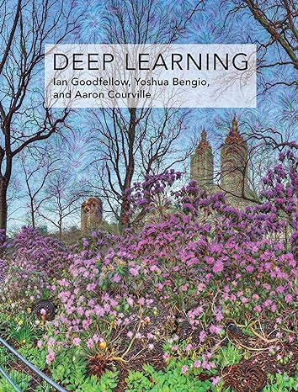
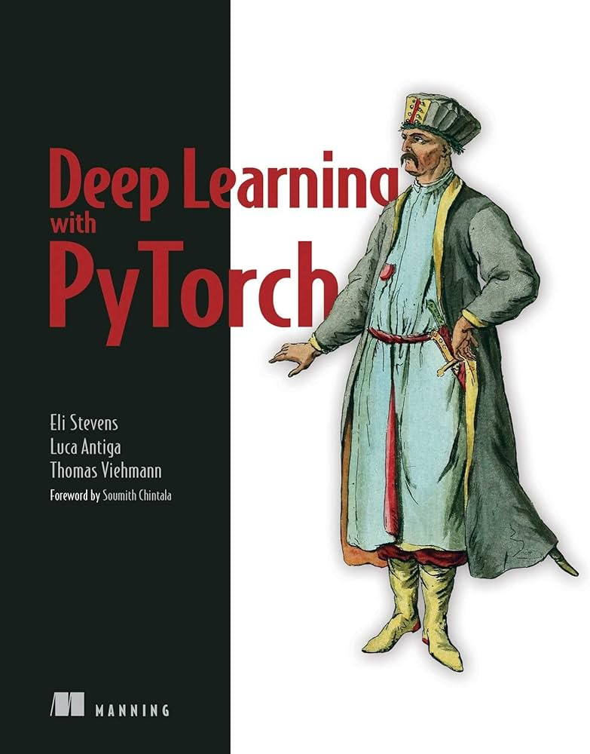
Resources
Both books are available online for free!
Course Introduction
Session 1

Slide 6
Contact
For all course-related matters you can contact me:
joacorreia@ucp.pt
OR
Jfscorreia95@gmail.com
Course Introduction
Session 1

Slide 7
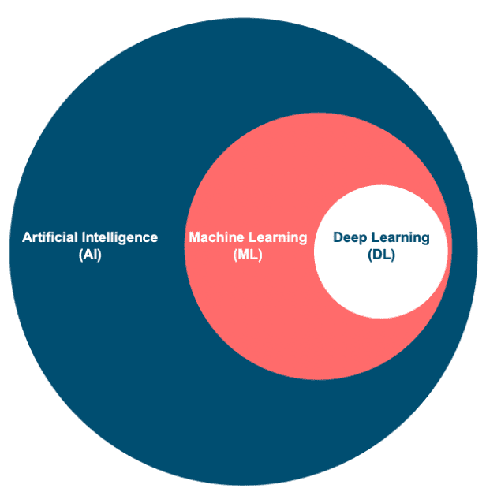
Deep Learning
Artificial Intelligence (AI): The broadest field focusing on creating machines capable of performing tasks that typically require human intelligence.
Machine Learning (ML): A branch of AI that enables systems to learn and improve from experience without explicit programming.
Deep Learning (DL): A specialized ML technique using neural networks with many layers to model complex patterns in data.
Course Introduction
Session 1

Slide 8




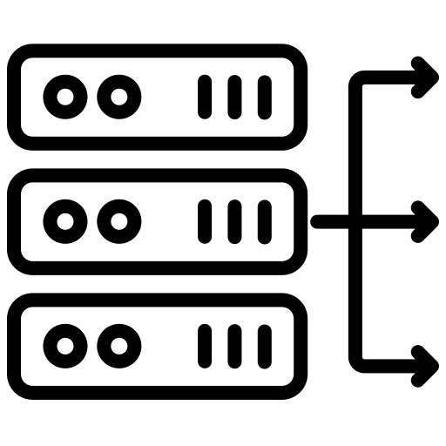

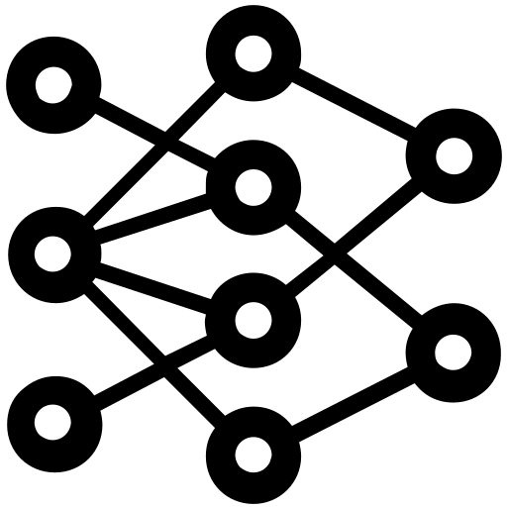


Deep Learning: Why now?
Sensor Data
Public Web
Big Data
Larger Datasets
Easier Collection and Storage
Hardware
Graphics Processing Units (GPUs)
Massively Parallelizable
Software
Improved Techniques
New Models
Toolboxes
Social Media
Documents
Course Introduction
Session 1

Slide 9
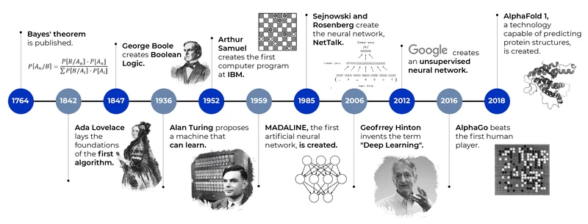
Deep Learning: Timeline
https://www.algotive.ai/blog/machine-learning-what-is-ml-and-how-does-it-work
Course Introduction
Session 1

Slide 10
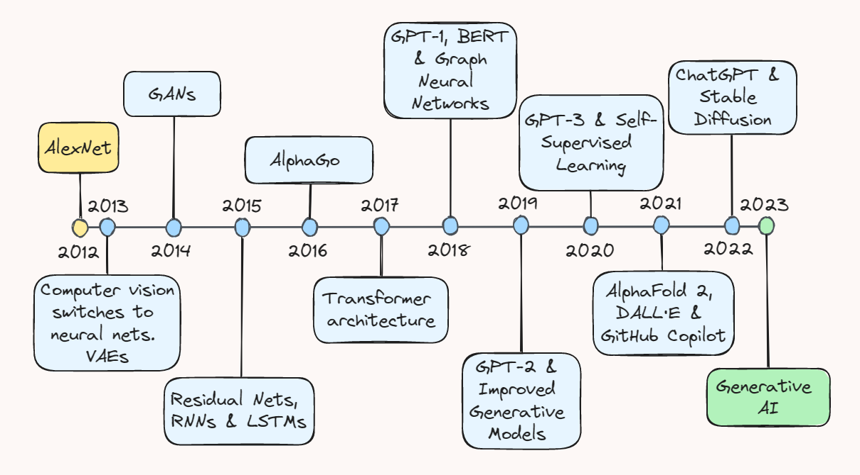
Deep Learning: The Last Decade
https://towardsdatascience.com/ten-years-of-ai-in-review-85decdb2a540
Course Introduction
Session 1

Slide 11
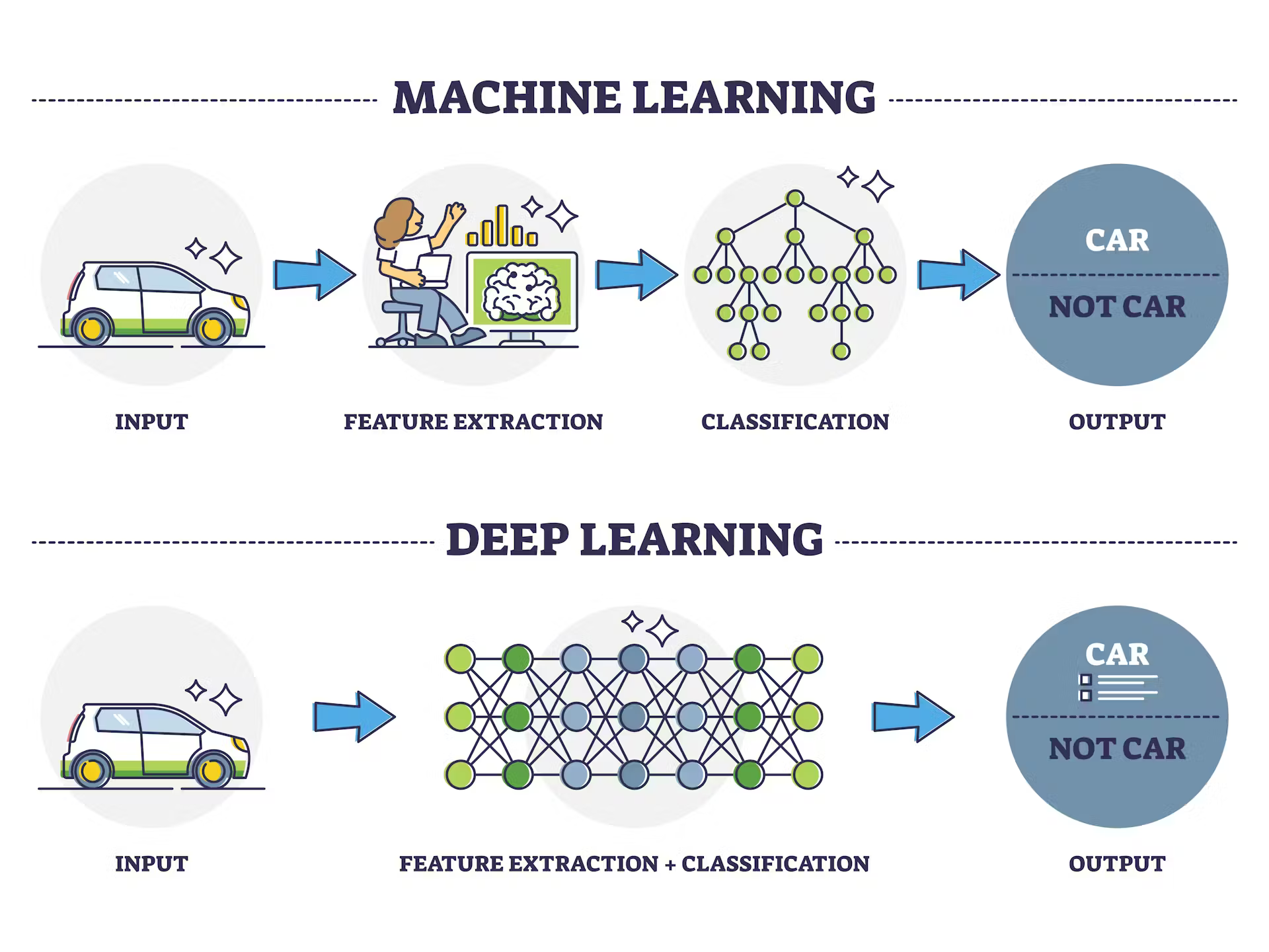
Why Deep Learning over Machine Learning?
https://www.turing.com/kb/ultimate-battle-between-deep-learning-and-machine-learning
Course Introduction
Session 1

Slide 12
Why Deep Learning over Machine Learning?
Challenging to hand-craft features!
https://www.turing.com/kb/ultimate-battle-between-deep-learning-and-machine-learning
Course Introduction
Session 1

Slide 13
Machine Learning Recap
General Idea:
Machine Learning is about turning data into useful insights and predictions with minimal human intervention.
Course Introduction
Session 1

Slide 14
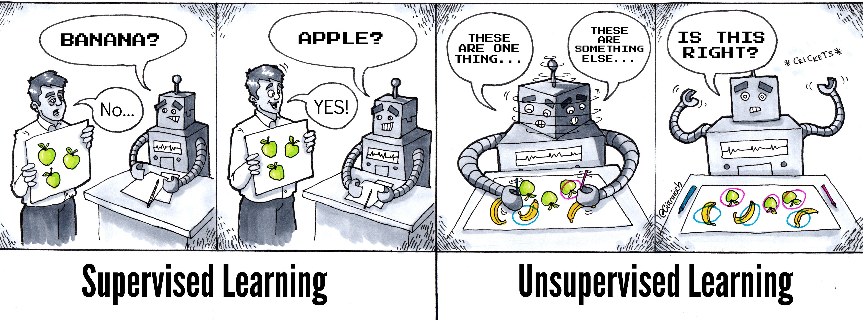
Unsupervised vs Supervised Learning
Illustration by @Ciaraioch
Course Introduction
Session 1

Slide 15
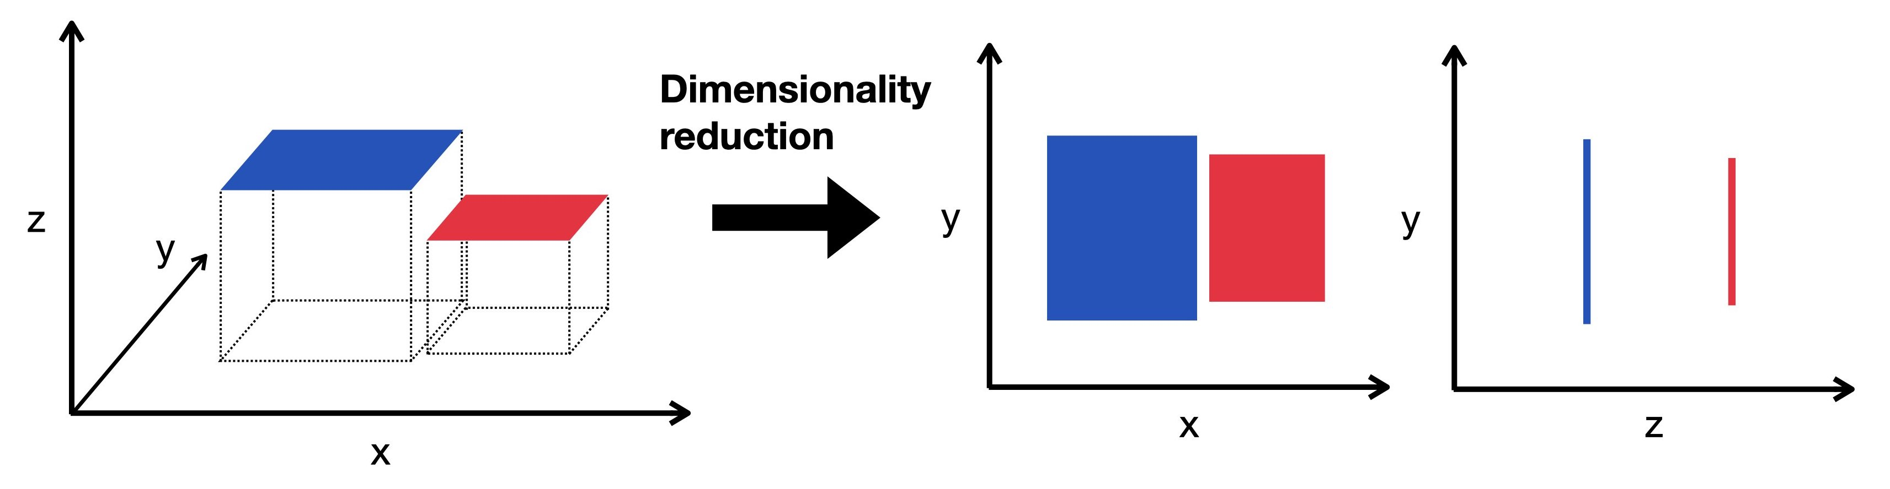
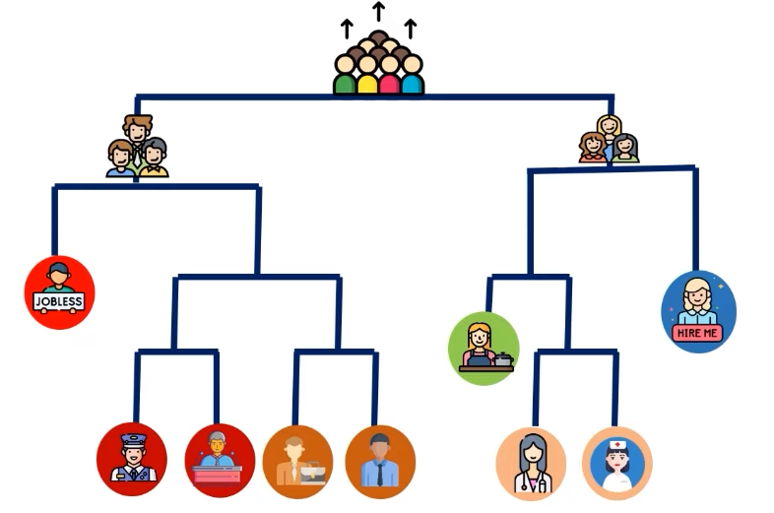
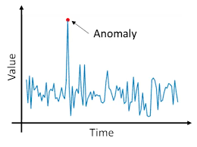
Types of Unsupervised Learning Tasks
Course Introduction
Session 1

Slide 16
Types of Unsupervised Learning Tasks
Dimensionality Reduction
Clustering
Anomaly Detection
Course Introduction
Session 1

Slide 17

Types of Supervised Learning
Course Introduction
Session 1

Slide 18
Types of Supervised Learning
Course Introduction
Session 1

Slide 19
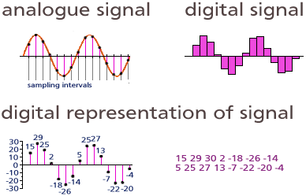

Data Types
Audio
Course Introduction
Session 1

Slide 20
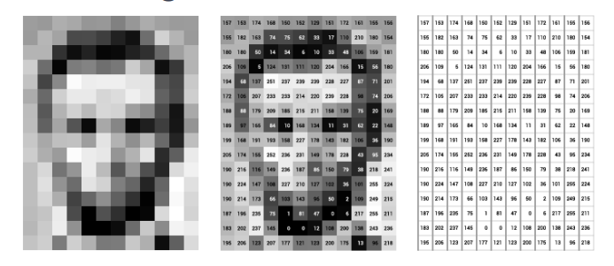
Data Types
Audio
Images
Course Introduction
Session 1

Slide 21
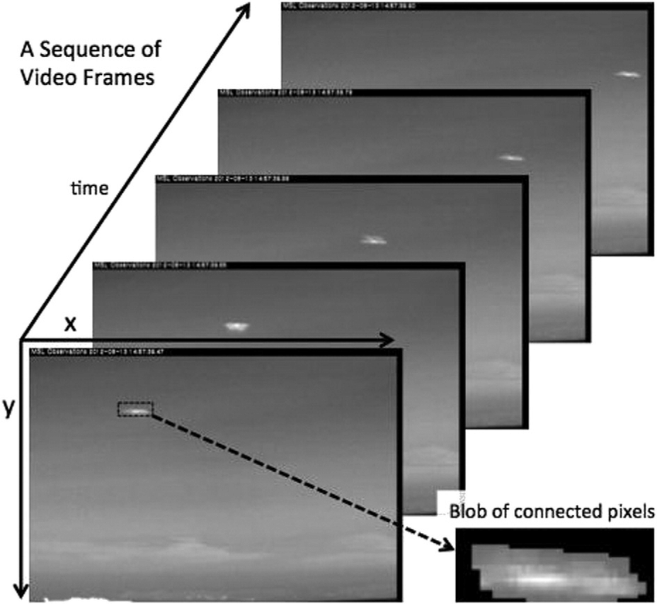
Data Types
Audio
Images
Video
Course Introduction
Session 1

Slide 22
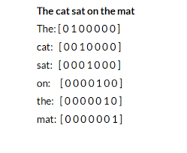
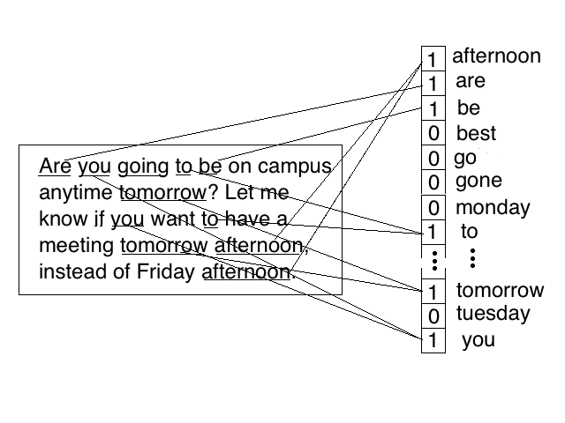
Data Types
Audio
Images
Video
Text
Course Introduction
Session 1

Slide 23
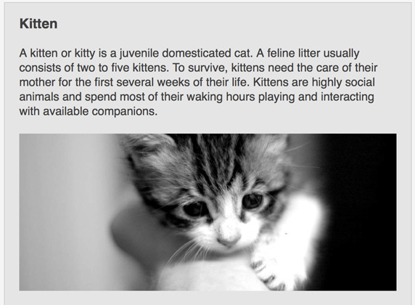
Data Types
Audio
Images
Video
Text
Multi-Modal (combinations of the above)
Course Introduction
Session 1

Slide 24

Deep Learning Applications
Spam Detection
Course Introduction
Session 1

Slide 25
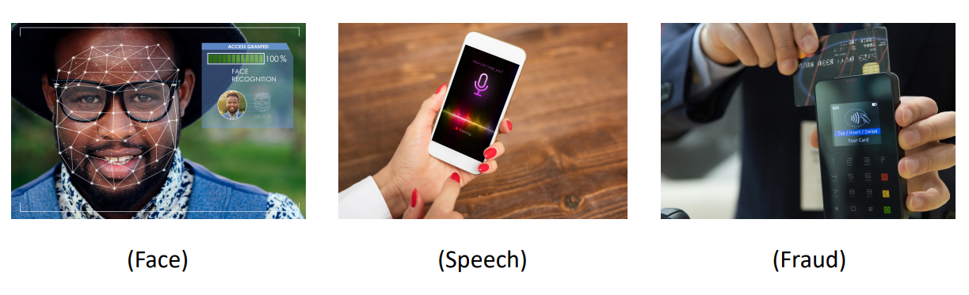
Deep Learning Applications
Recognition
Course Introduction
Session 1

Slide 26
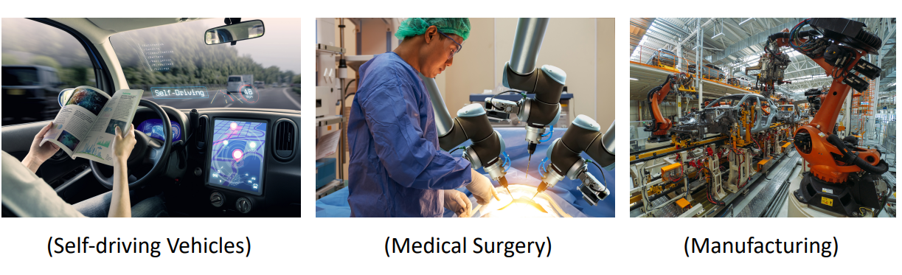
Deep Learning Applications
Robotics
Course Introduction
Session 1

Slide 27
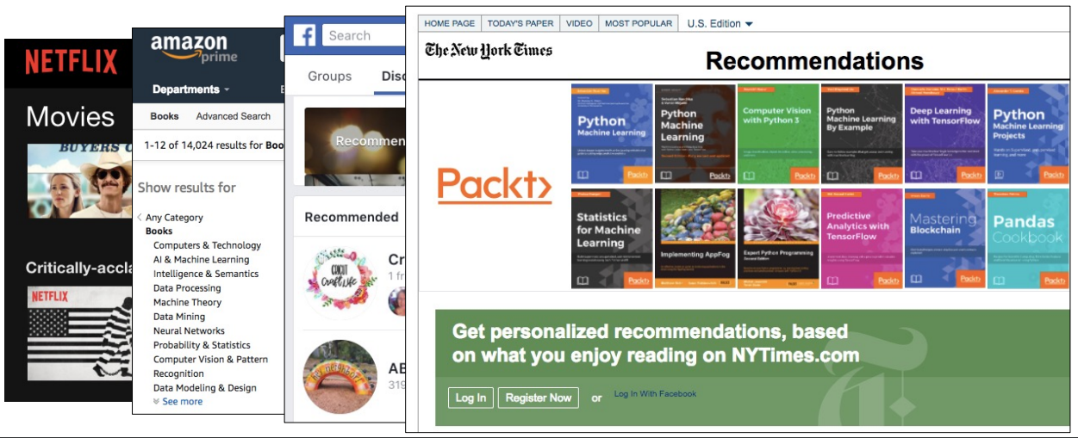
Deep Learning Applications
Recommendation Systems
Course Introduction
Session 1

Slide 28
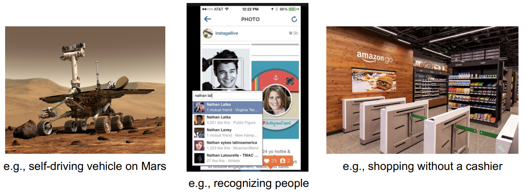
Deep Learning Applications
Computer Vision Systems
Course Introduction
Session 1

Slide 29
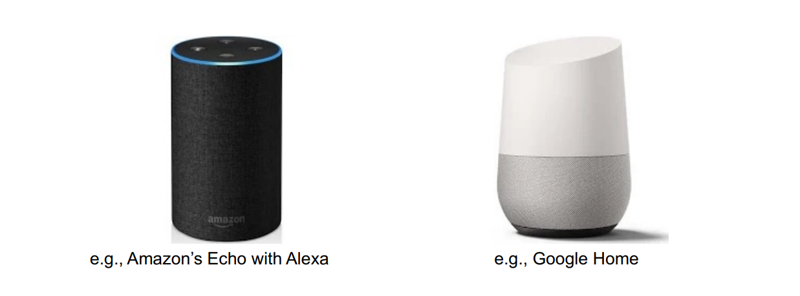
Deep Learning Applications
Home Virtual Assistants
Course Introduction
Session 1

Slide 30
GitHub SetUp
Lectures will be provided both on GitHub and Moodle.
https://github.com/LCDA-UCP/dl_with_pytorch
You will need to fork the repository and then clone it to your local machine.
Setup a python/conda environment and install the requirements.
$ pip install –r requirements.txt
Course Introduction
Session 1

